Slide 1
World Happiness Analysis and Prediction
Group 2:
Keqi Zhang, Zhichun Xiao, Cheritha Kondru, Junemo Moon
2025FA - REGRES TIME SER 16:954:596:02

Slide 2
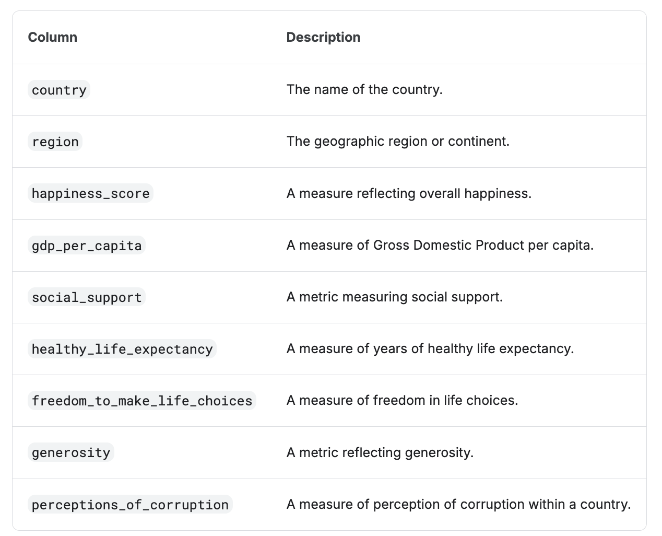
Dataset
2015 up to 2023
1367 observations
Western Europe/North America and ANZ/Latin America and Caribbean/Middle East and North Africa/Southeast Asia/East Asia/Central and Eastern Europe/ Africa/Sub-Saharan Africa/Commonwealth of Independent States
Kaggle – Global Happiness Scores and Factors (2015–2023)
https://www.kaggle.com/datasets/sazidthe1/global-happiness-scores-and-factors

Slide 3
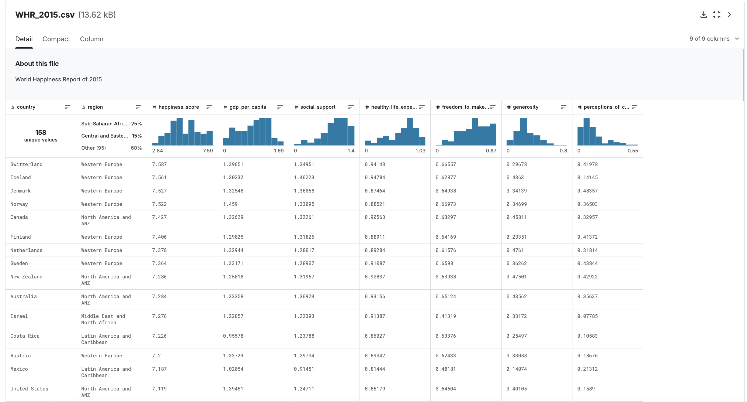

Slide 4
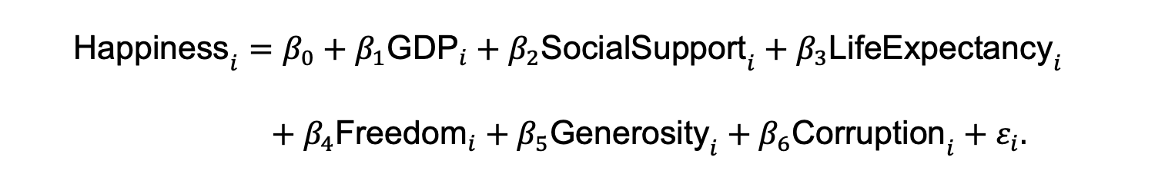
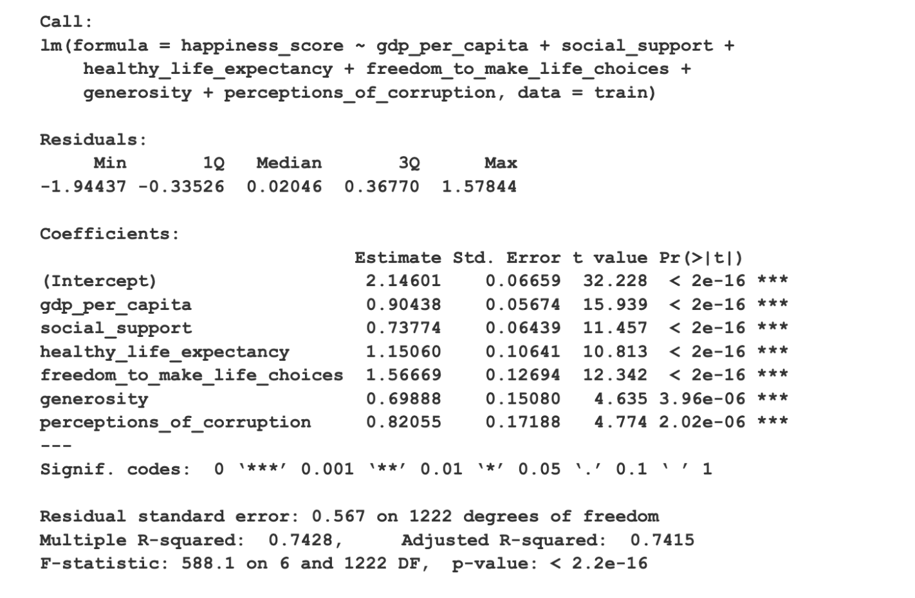
Regression model
2015-2022 data as the training set and the 2023 data as the testing set

Slide 5
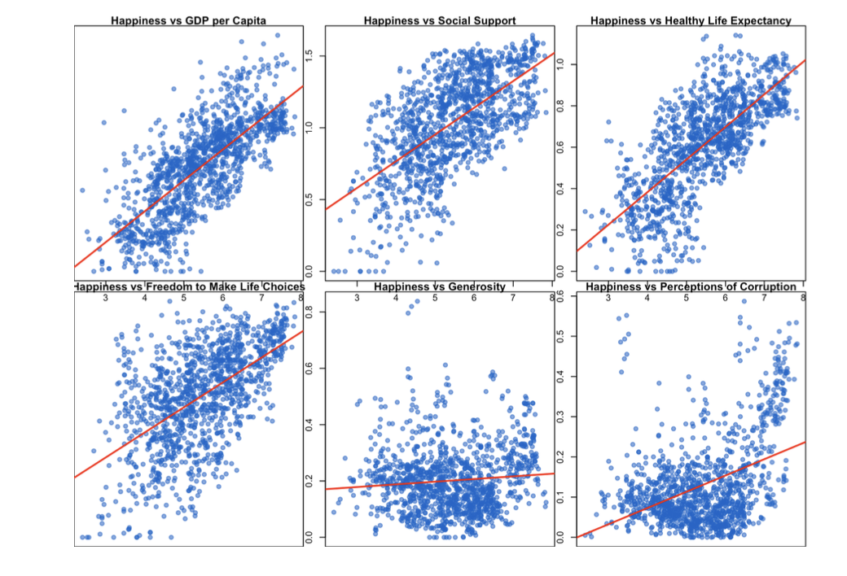
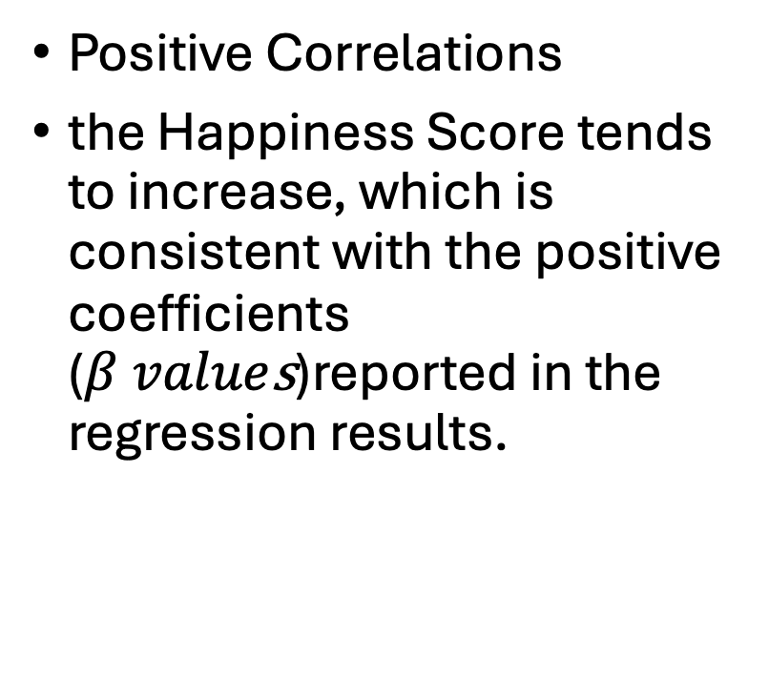
Relationship between response variable & six explanatory variables
Positive Correlations
the Happiness Score tends to increase, which is consistent with the positive coefficients ($β value$s)reported in the regression results.

Slide 6
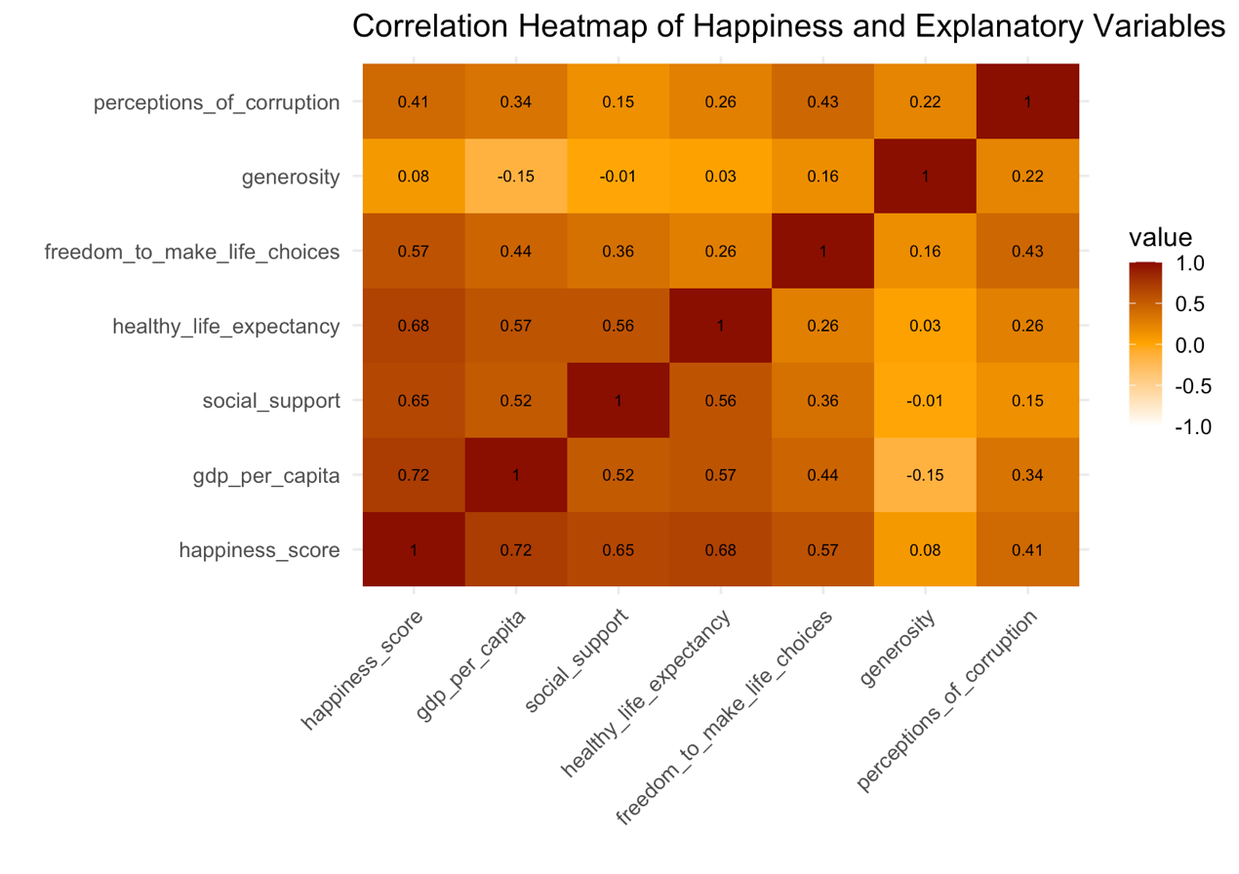
Heat map
Red/Dark Orange (Closer to 1.0): Indicates a strong positive correlation.
gdp_per_capita=0.72 is strongest positive correlation; higher GDP is associated with higher happiness.
Comparing the correlation from the heatmap to the regression coefficients
bivariate relationship and a multivariate relation

Slide 7
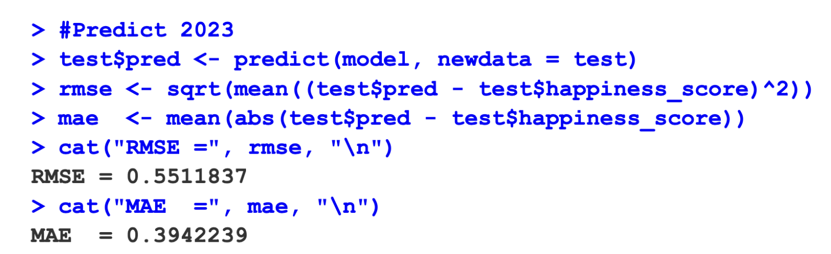
Prediction performance
RMSE (Root Mean Square Error) quantifies the average magnitude of errors between predicted values from a model and actual observed values, calculated as the square root of the average of the squared differences, indicating model accuracy.
MAE(mean absolute error) is a measure of the average magnitude of errors between paired observations.
It is calculated by summing the absolute differences between predictions and actual values, then dividing by the number of observations.

Slide 8
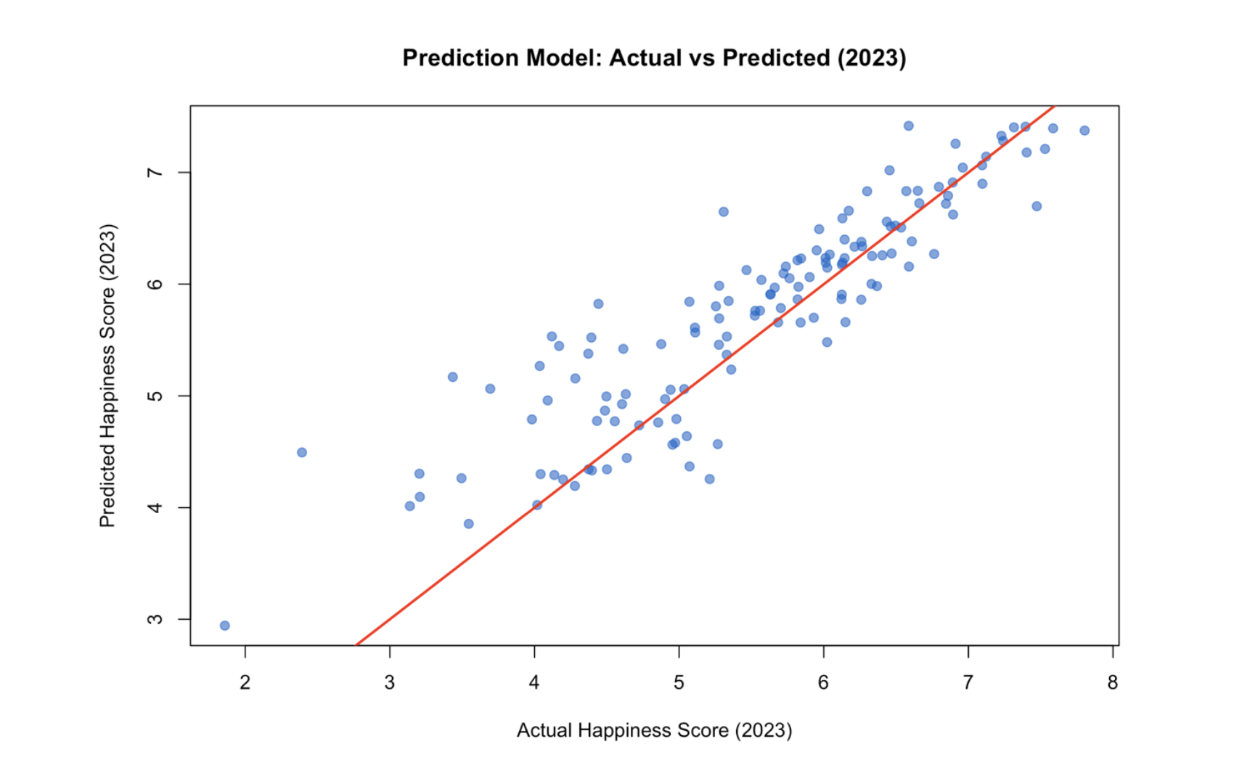
Prediction performance
Overall Fit: The majority of the blue data points cluster tightly around the red line, indicating that the model's predictions are highly accurate for most countries in 2023. (perfect prediction line.)

Slide 9
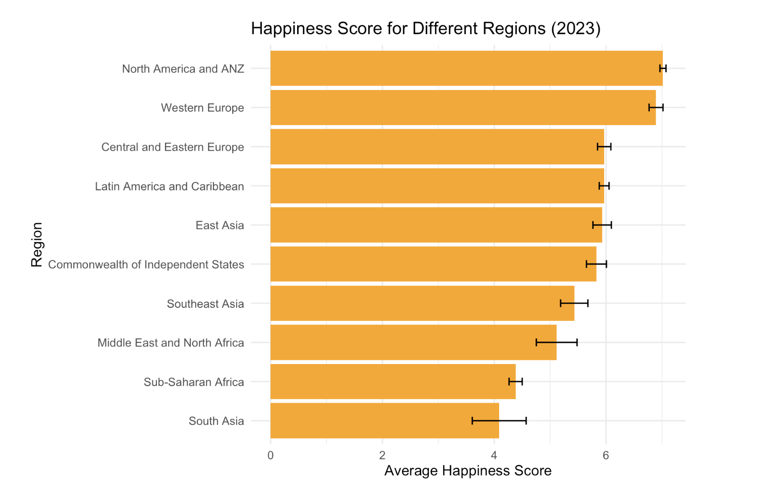
Predicted average happiness scores across major world regions in 2023 (including error)
The two regions predicted to be the happiest are at the top of the chart:
North America and Western Europe
The black “H” bars represent the prediction error or margin of error associated with that regional average.
The fact that these error bars are relatively small indicates that the model's predictions are precise. This is consistent with the low overall error metrics (MAE and RMSE) found in the model's performance analysis.

Slide 10
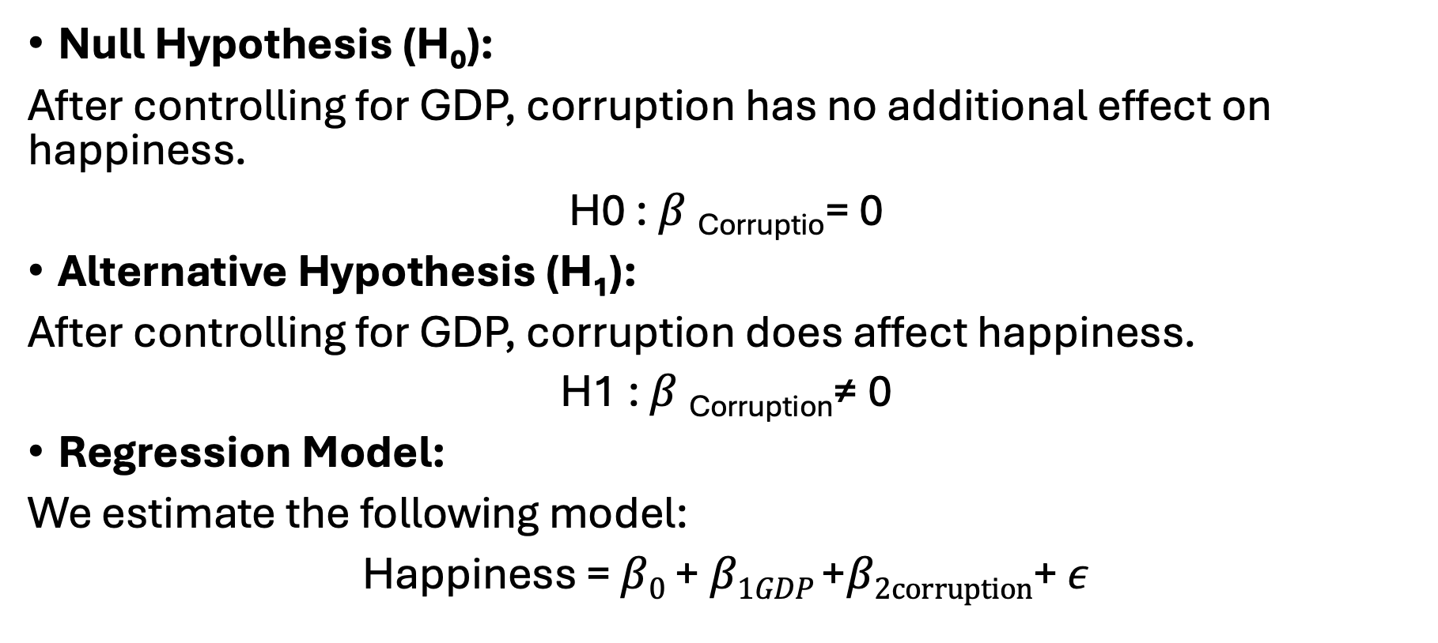
Hypothesis 1: Does Corruption Affect Happiness After Controlling for GDP?
Null Hypothesis (H₀):
After controlling for GDP, corruption has no additional effect on happiness.
H0 : $β \text{Corruptio}$= 0
Alternative Hypothesis (H₁):
After controlling for GDP, corruption does affect happiness.
H1 : $β \text{Corruptio}\text{n}$≠ 0
Regression Model:
We estimate the following model:
Happiness = $β0$ + $β1GDP$ +$β2corruption$+ $ε$

Slide 11
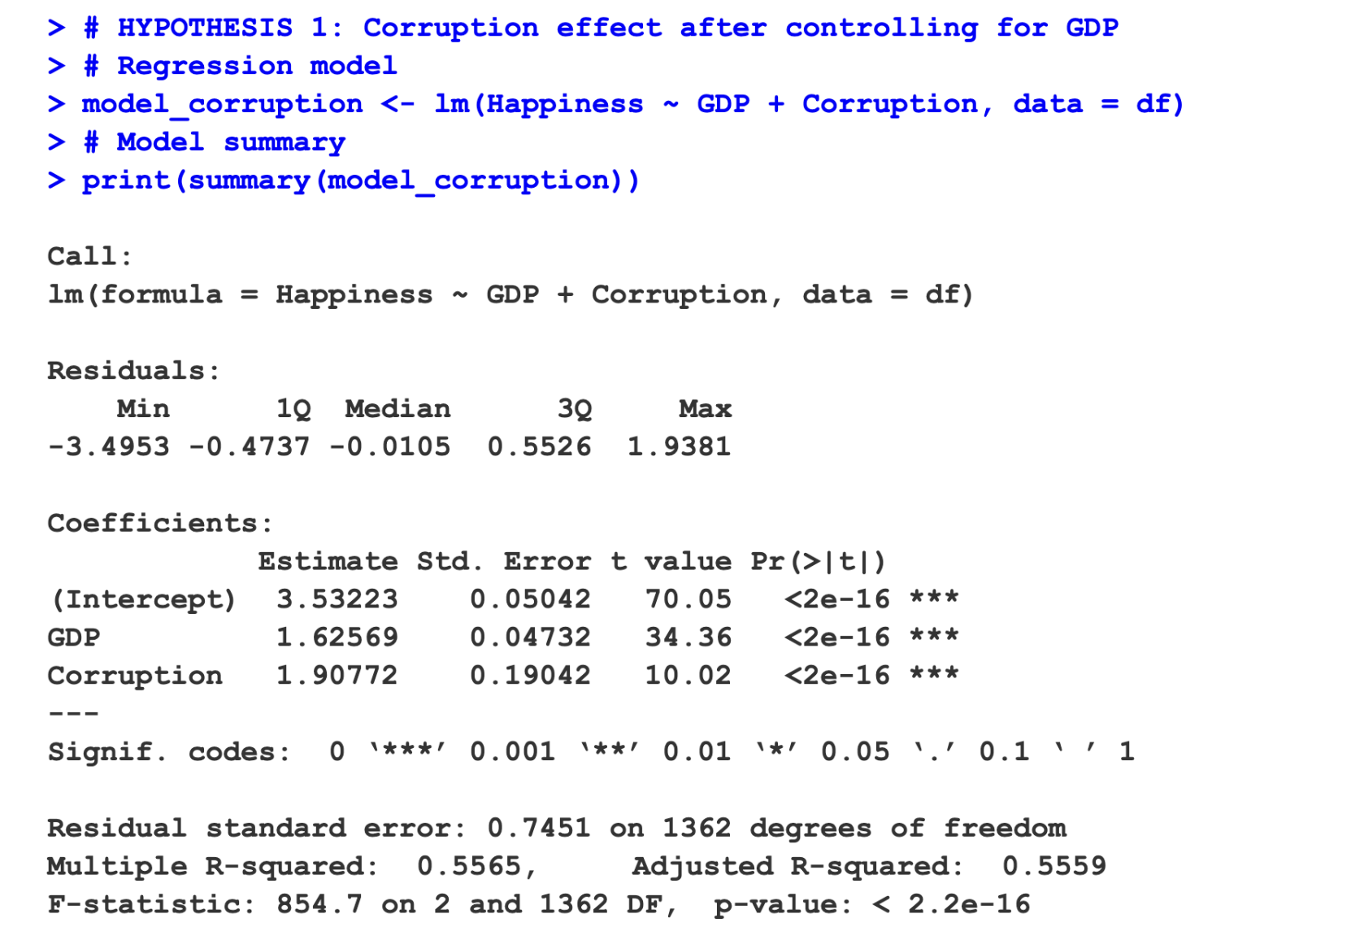

Slide 12
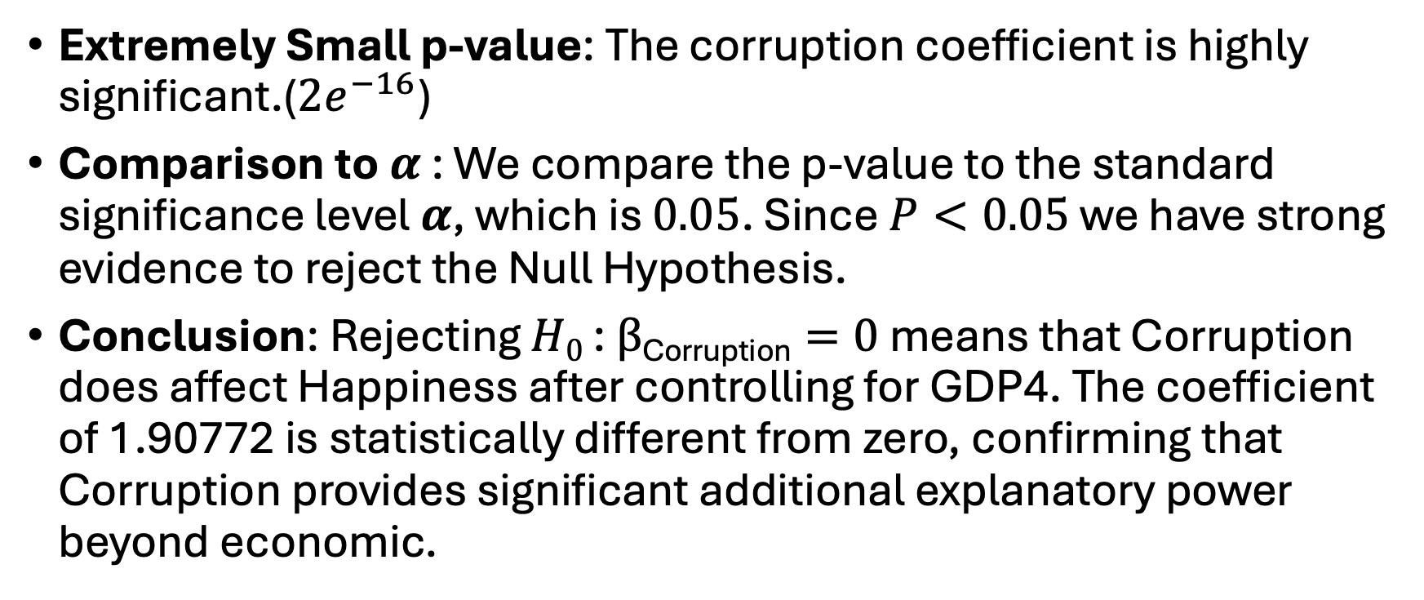
Model Output
Extremely Small p-value: The corruption coefficient is highly significant.(${2e}^{−16}$)
Comparison to$α$ : We compare the p-value to the standard significance level $α$, which is $0.05$. Since $P<0.05$ we have strong evidence to reject the Null Hypothesis.
Conclusion: Rejecting $H0$ : $β\text{Corruption}=0$ means that Corruption does affect Happiness after controlling for GDP4. The coefficient of 1.90772 is statistically different from zero, confirming that Corruption provides significant additional explanatory power beyond economic.

Slide 13
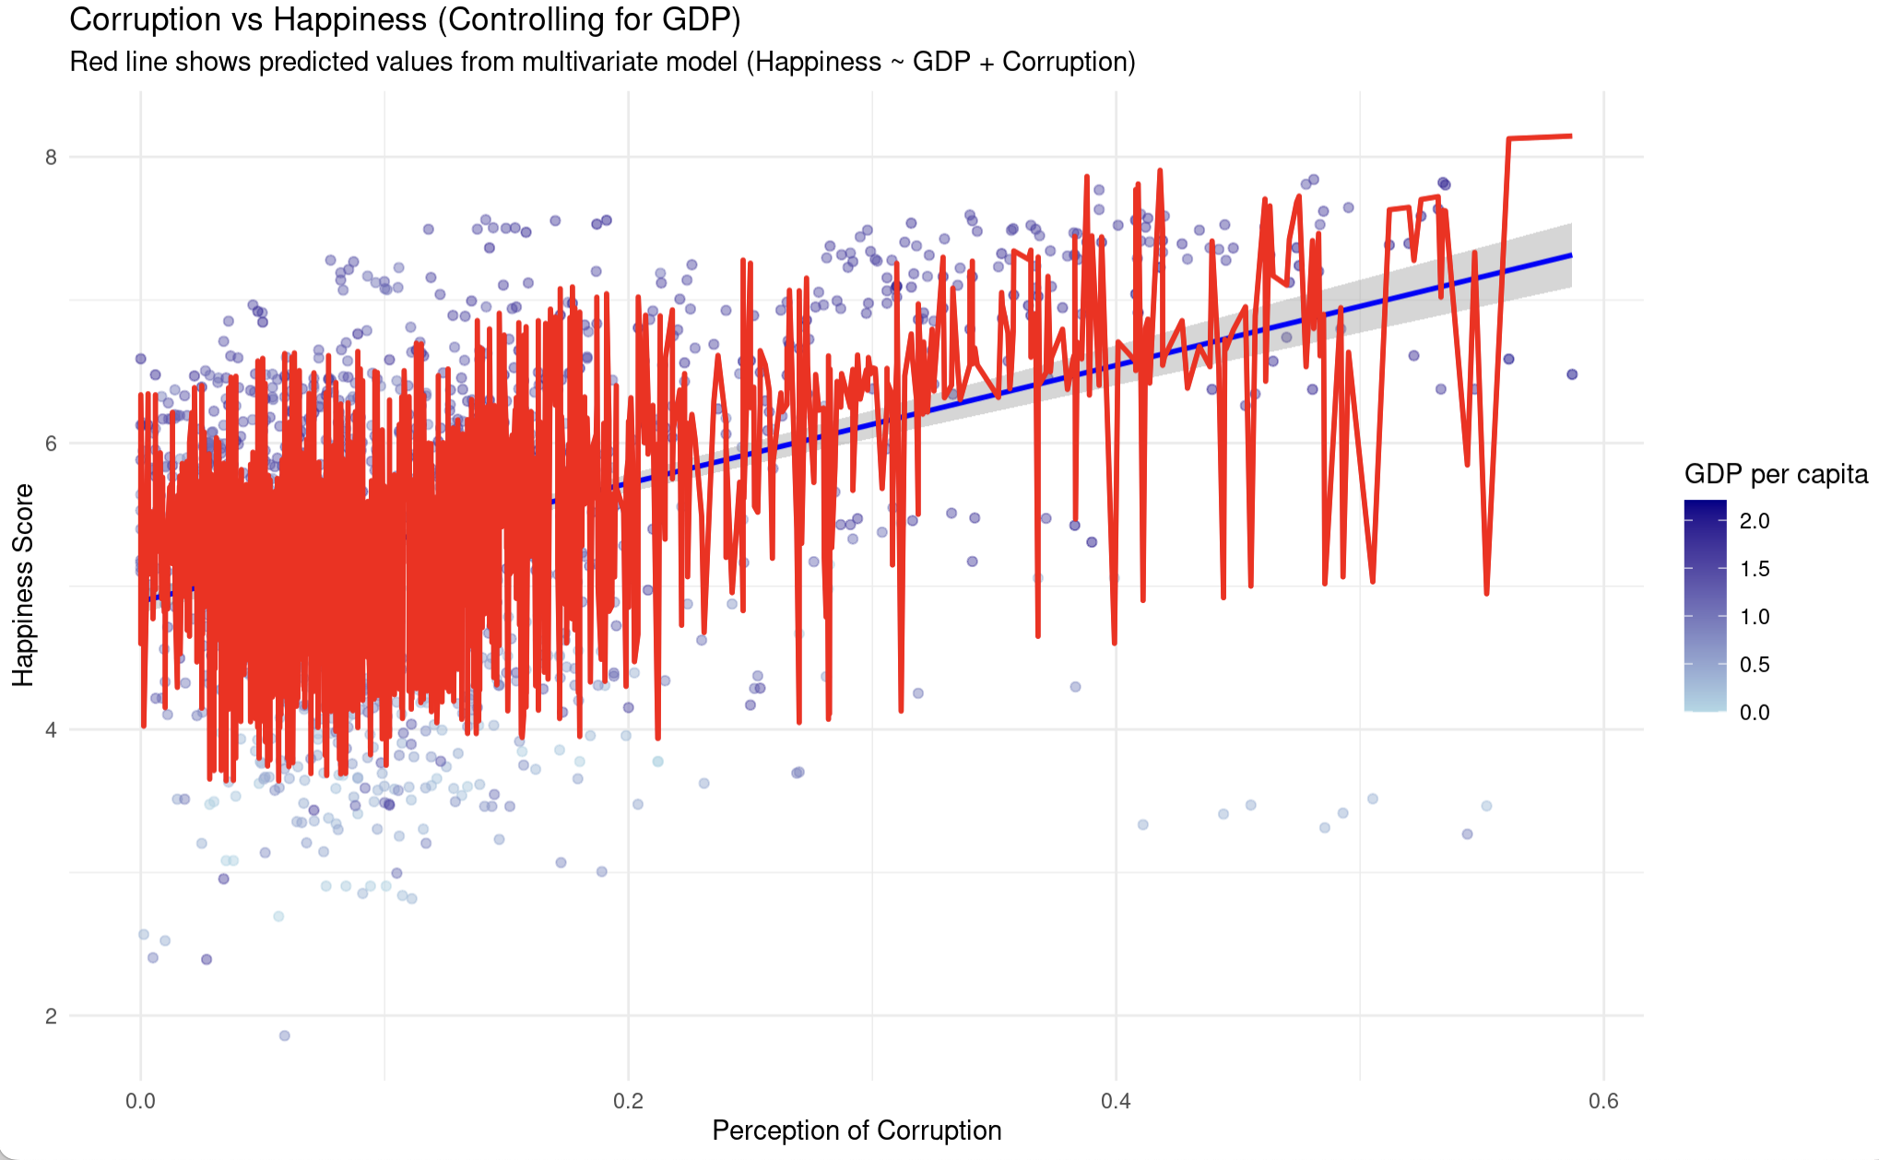
Model Output
The Counterintuitive result: as Corruption Perception increases Happiness increases.
Higher X-values = LESS corruption perceived in the dataset.

